Slide 1
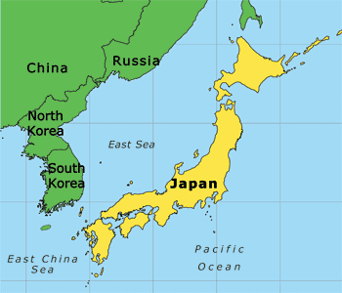
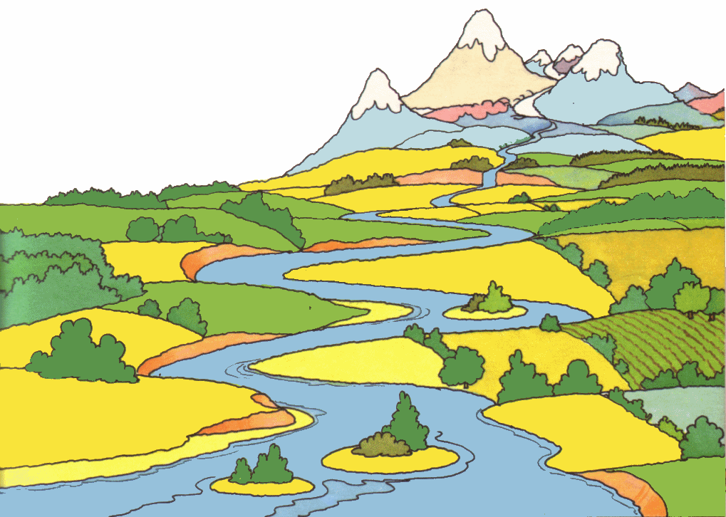
The Emergence of Japan and the Feudal Age:
Section 4
Japan is on an archipelago – a chain of islands
100 miles off Asian mainland, E. of Korea
Four-fifths of land too mountainous to farm
Mild climate and rainfall help people farm and settle
in river valleys
Geography Sets Japan Apart

Slide 2
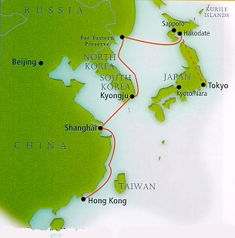
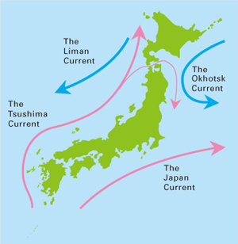
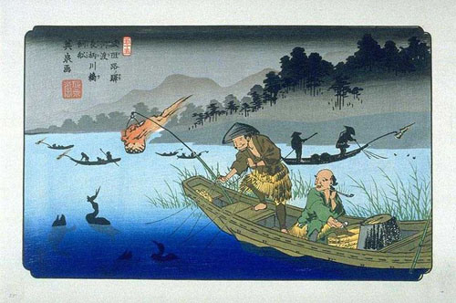
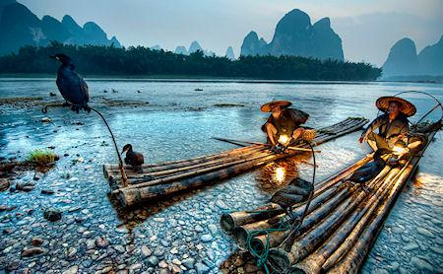
Geography Sets Japan Apart –
Being an Island Chain can be Beneficial:
Seas protect & isolate Japan, helps to preserve identity
Good trade routes
Thriving fish Industry

Slide 3
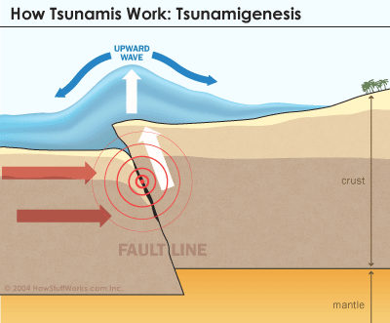
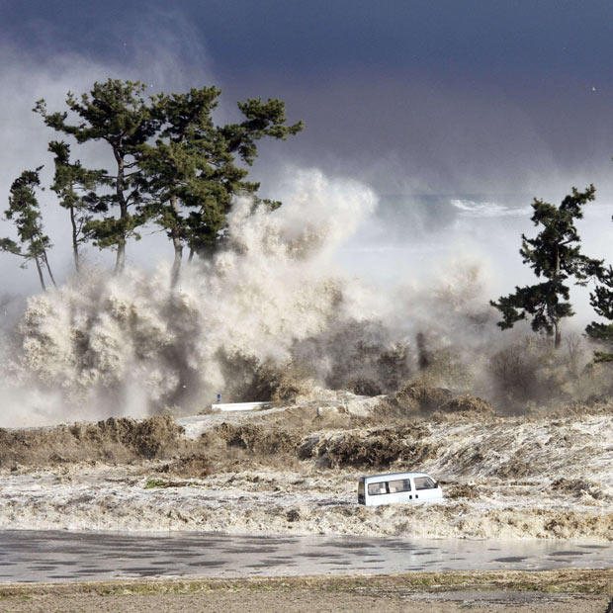
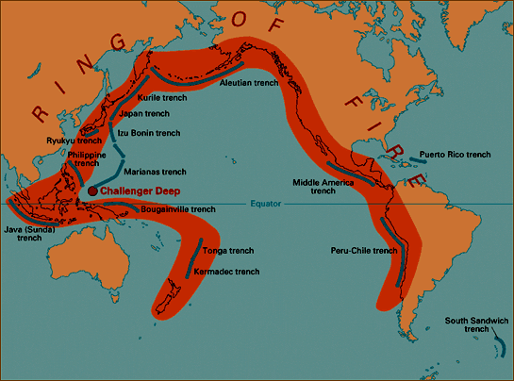
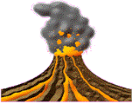
Geography Sets Japan Apart
Japan is in the “Ring of Fire” - a chain of volcanoes that encircle Pacific Ocean
Frequent volcanic activity & earthquakes
Underwater earthquakes cause killer tidal waves = tsunamis
Little or no warning, wipe out everything in path

Slide 4
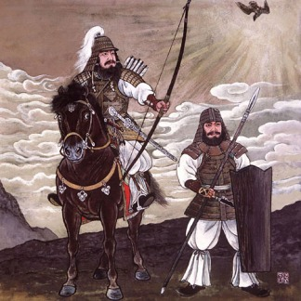
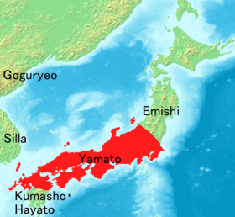
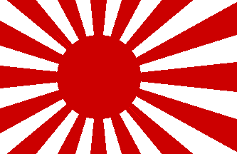
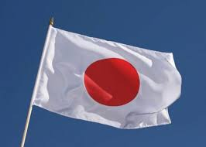
Early Japanese society divided into UJI, clans
Each had own chief & special god or goddess
Some women were chiefs, respected position
500 A.D. Yamato Clan dominated
Ruled 1,000 years
Japan’s first dynasty
Rising Sun clan symbol is still used today
Early Traditions

Slide 5
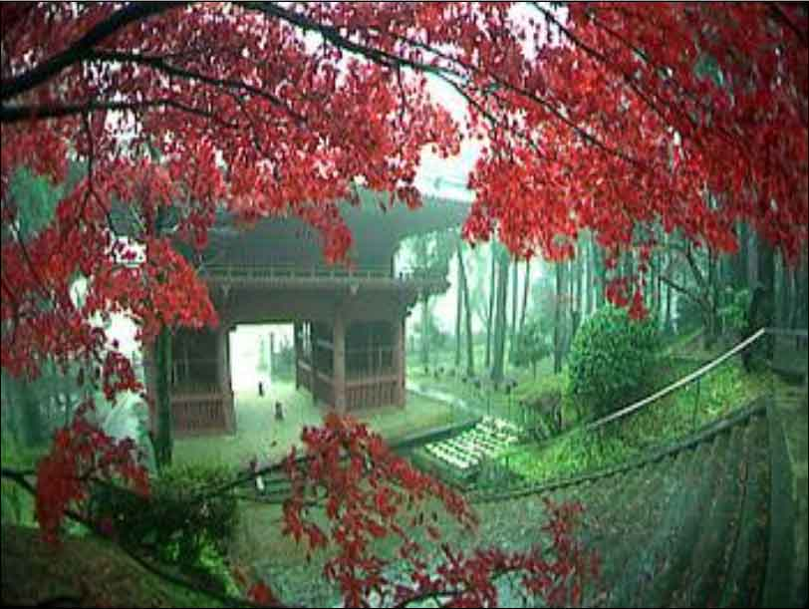
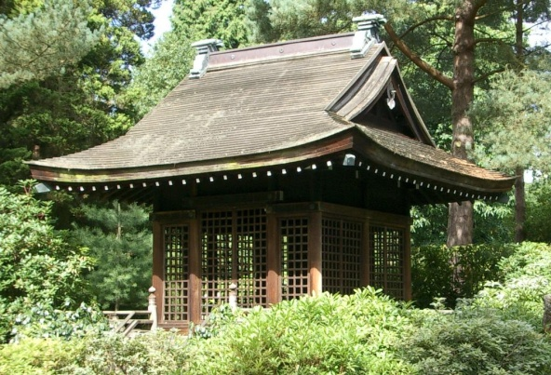
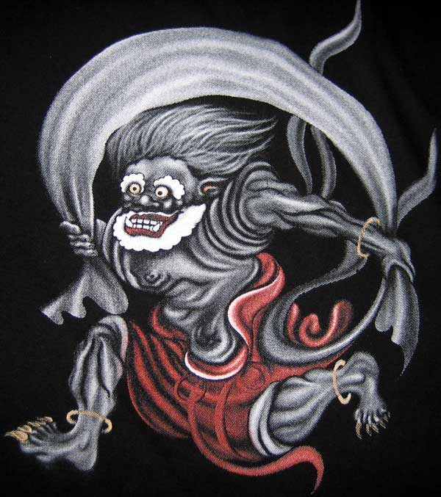
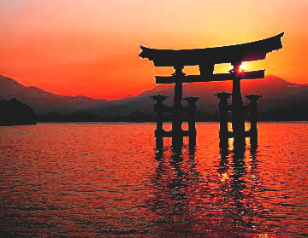
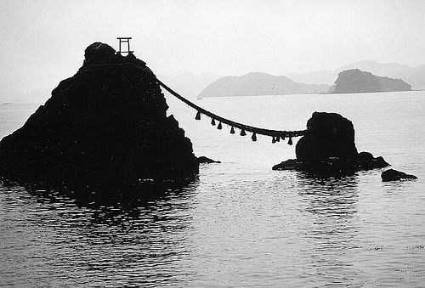
Shinto means “the way of the kami” Kami is the Japanese word for a god, deity, divinity, or spirit. It has been used to describe mind (心霊), God (ゴッド), supreme being (至上者),, and anything that is worshipped.
Worshiped the forces of nature
Tradition still survives in Japan
Simple Shinto shrines are
all over Japan
Located in beautiful, natural settings
Dedicated to special sites, mountains, waterfalls,
ancient trees, even rocks
Shinto – A Religion of Nature & Simplicity
Shinto god of wind

Slide 6
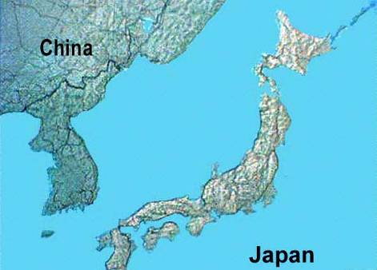
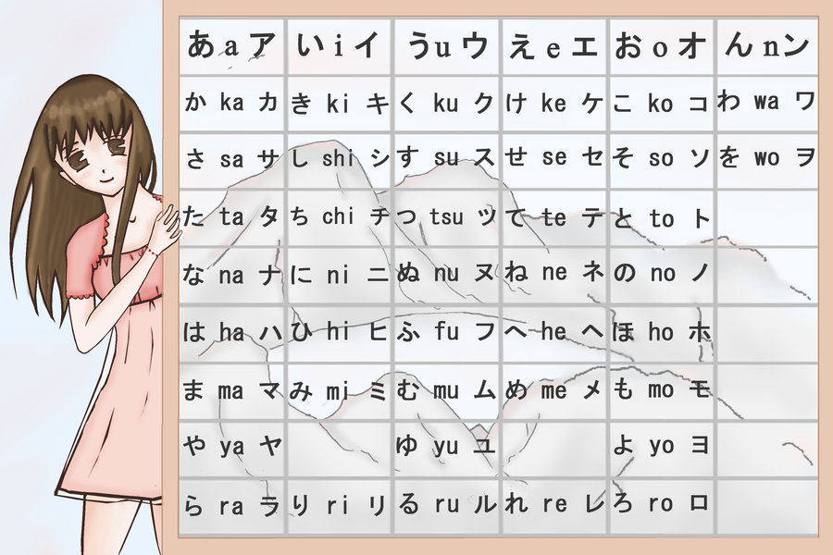
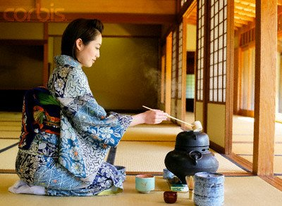
Chinese Influence on Japanese Identity
Japan borrowed many Chinese ideas and innovations
Chinese writing script and literature
Governmental organization
Buddhism
Persistence of Shinto
Emperors claimed divine absolute power = “Heavenly Emperor”
Tea Ceremony
Developed own writing in 900 A.D. = KANA – phonetic symbols represent syllables = increased literacy rate
Modified and discarded some ideas =
selective borrowing creates unique culture
Notes:
China had a significant impact on the development of early Japan because the two countries were located so closely to each other. The Chinese, however, were stronger and richer than Japan and dominated the Far East (including Korea and Vietnam) both culturally and militarily for centuries.
The Japanese incorporated many Chinese ideas and innovations, including Chinese writing script, Chinese literature, and governmental organization and bureaucracy. The most significant Chinese import may have been Buddhism, which was introduced into Japan in the sixth century. Buddhism eventually became highly influential in the political development of Japan.
Even though Japan adopted Chinese Confucian and Buddhist traditions, the Japanese did not abandon their native religion, Shinto, which emphasizes veneration and worship of nature. Shinto centers on the belief that all elements of nature (from waterfalls to boulders) contain some elements of the divine, called kami. Unlike other religions, Shinto has no strictly delineated moral code; instead, it simply stresses purity.

Slide 7
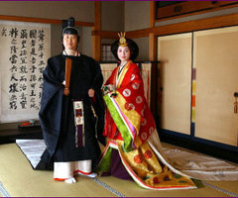
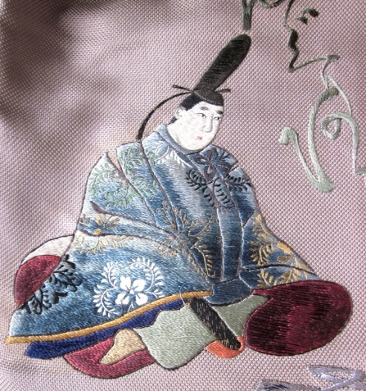
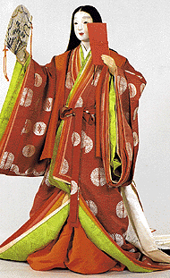
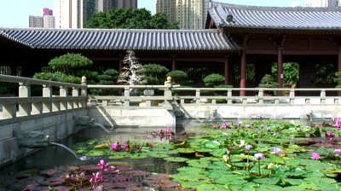
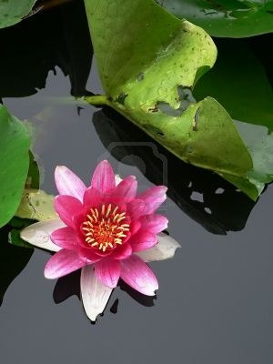
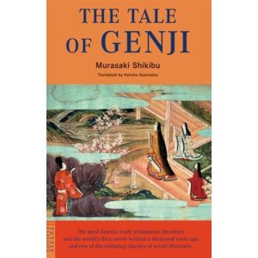
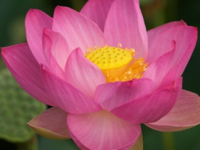
The Heian Period
794 – 1185 A.D.
Emperors ceremonial only
Fujiwara (noblemen) held real power
Noblemen & women lived in fairytale elegance:
Beautiful pavilions
Gardens & lotus pools
Dressed in silk
Men studied Chinese; women could not
Fortunately, Murasaki Shikibu broke rules:
She wrote world’s first full length novel: The Tale of Genji

Slide 8
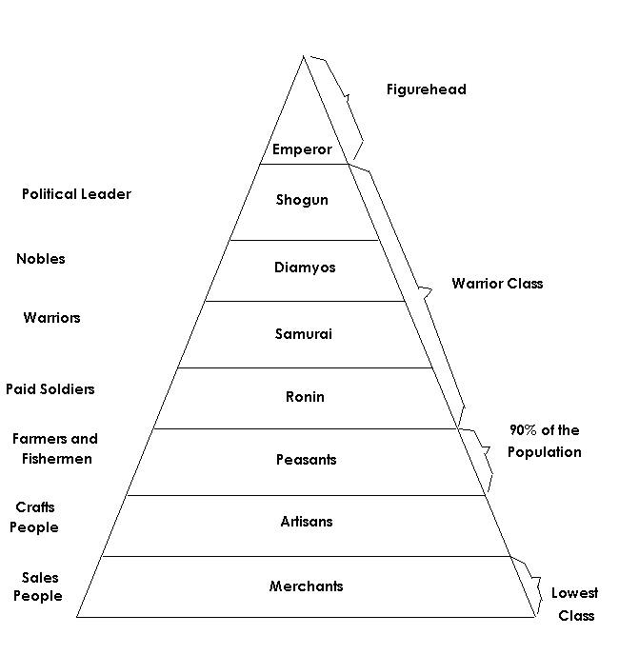
Warriors Establish Feudalism
Feudal warfare swept Japan in 1403
People loyal to local warlords, not central government
Emperor = almost no power – respected figurehead
Warrior aristocracy dominated
Shogun = supreme military commander
75% of population

Slide 9
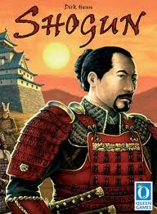
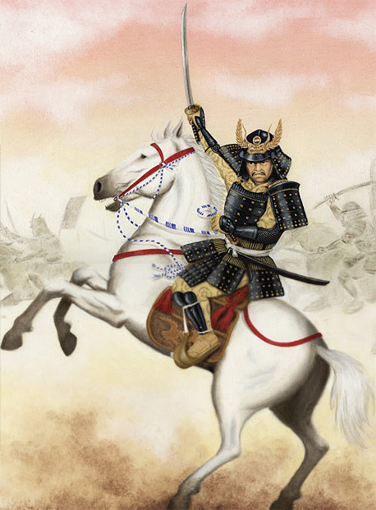
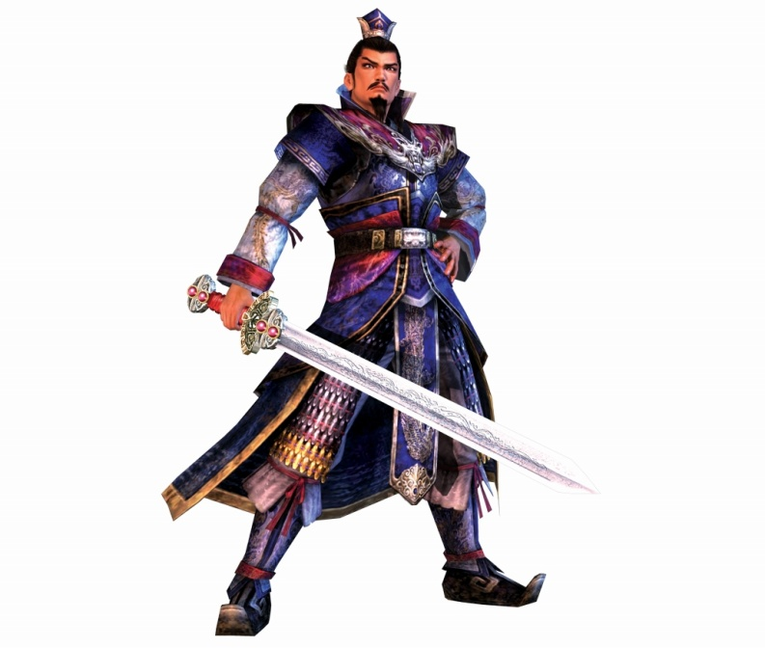
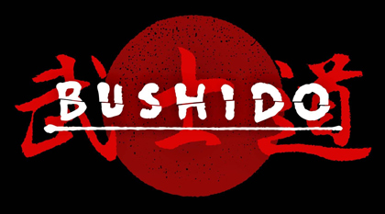
Shogun initially controlled only part of Japan – later on controlled all of Japan
Vassal Lords promised to support Shogun w/armies
Warrior Lord = Daimyo
highly skilled Warriors = Samurai, “those who serve”
Armed & Trained like knights in Europe
Code of Values (like chivalry) = Bushido
The Ways of the Warrior

Slide 10
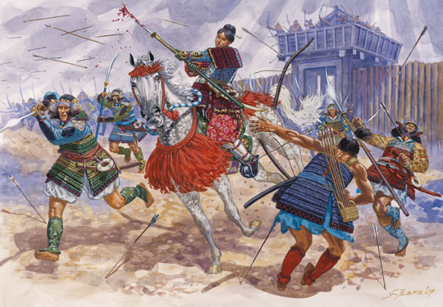
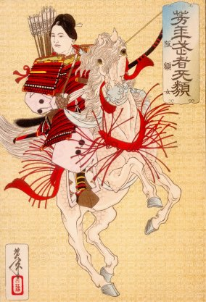
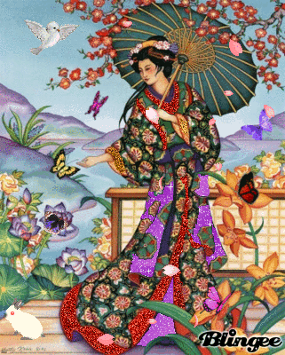
Noblewomen Lose Ground
At first women could be trained in military
Samurai progressed – women lost power
Could not inherit
Women not on pedestal
Must endure hardships

Slide 11
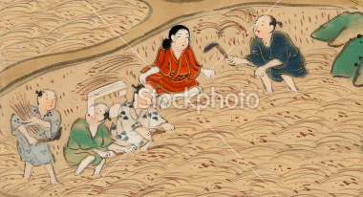
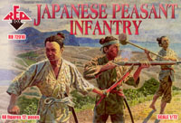
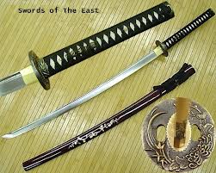
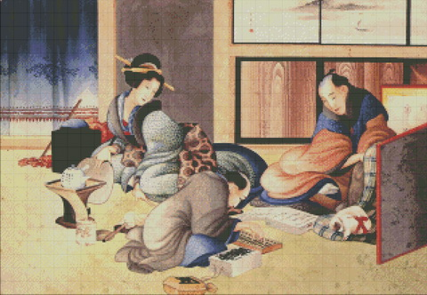
Peasants, Artisans, & Merchants
Peasants made up 75% of population
Cultivated rice & other crops
Some were foot soldiers – could work way up to Samurai
Artisans made armor, swords & other goods
Merchants lower rank – eventually improved status

Slide 12
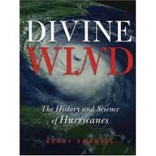
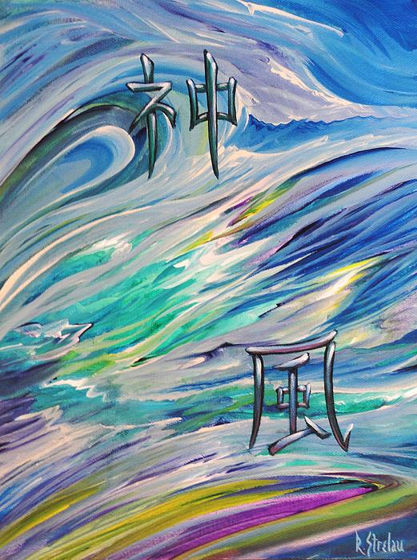
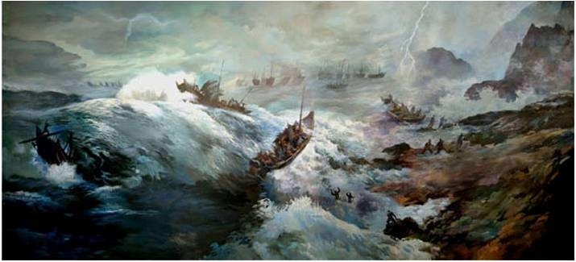
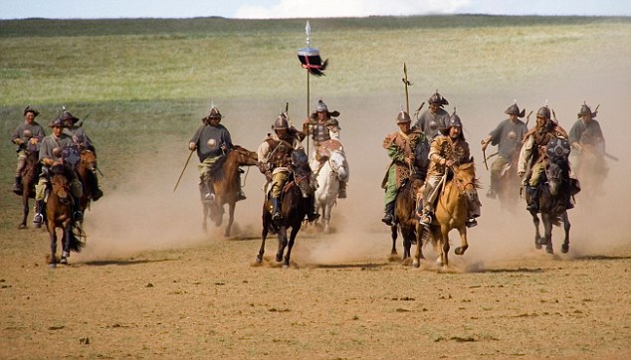
Japan Hold Off Mongols
Mongols launched invasion in 1274 A.D.
Japanese refused to accept
30,000 Mongols invaded
Then, typhoon (like a hurricane) wrecked all Mongol ships
1281 New Mongol fleet launched
Again, typhoon drove them back
Japanese gave credit for salvation to the Kamikaze = divine winds
Believed they were special & protected by gods

Slide 13
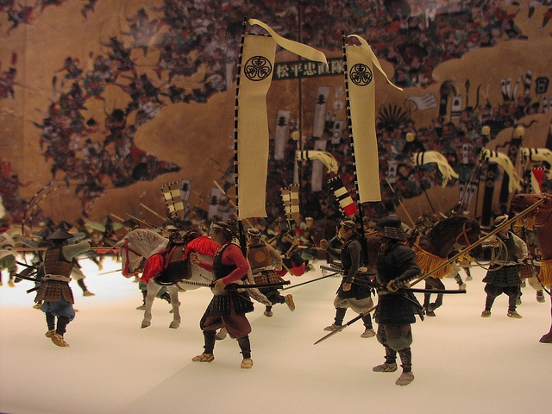
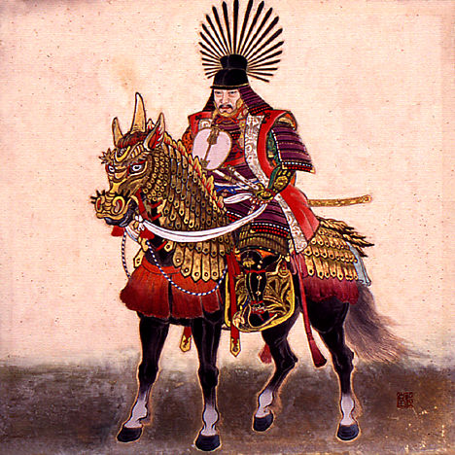
Tokugawas Unite Japan
1590 Tokugawas controlled most of Japan
Tokugawa Shogunate lasted until 1868
Formed central government
Unified, orderly society
Military & government officials – only Samurai allowed
Lower classes forbidden to wear silk

Slide 14
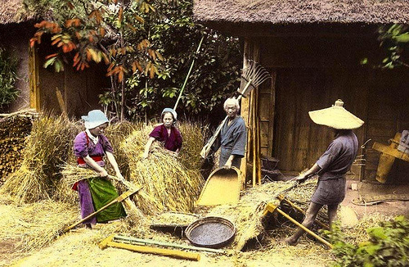
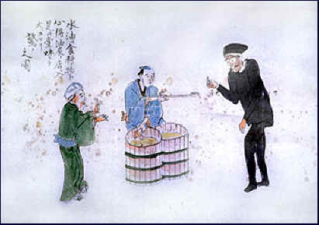
Agriculture improved: new seeds, tools & fertilizers
Food surplus = population growth
Towns w/merchants & artisans sprang up
New roads = trade flourished
Wealthy merchant class emerged
Economy Booms

Slide 15
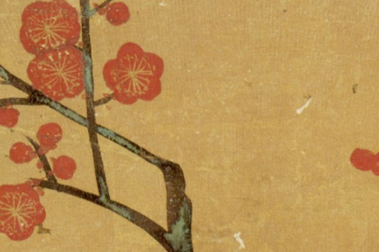
Zen Buddhism Shapes Culture
Seek enlightenment through meditation
Elaborate tea ceremony
Beautiful landscape paintings & gardens
Buddhist sect from China = Zen = self-reliance, meditation, devotion to duty
Monks were
scholars
Stressed compassion
Monks had rigid rules
Try and go to Morakami Gardens in Boca Raton – Beautiful and peaceful – Definitely worth the trip – around 40 minutes away, right off of I-95.

Slide 16
Noh Plays develop in 1300s
Chorus, fairy tales
Emphasize renouncing selfish pleasures
Artistic Traditions Change
1600s Kabuki drama
Less refined
Had comedy & melodrama
Puppet plays
also popular

Slide 17
Painting and Printmaking
Reflected Chinese landscape painting
But – developed own style
Some depicted historical events
1600s developed woodblock

